Slide 1

Sports Analytics III
Produced by Dr. Mario
UNC STOR 538

Slide 2
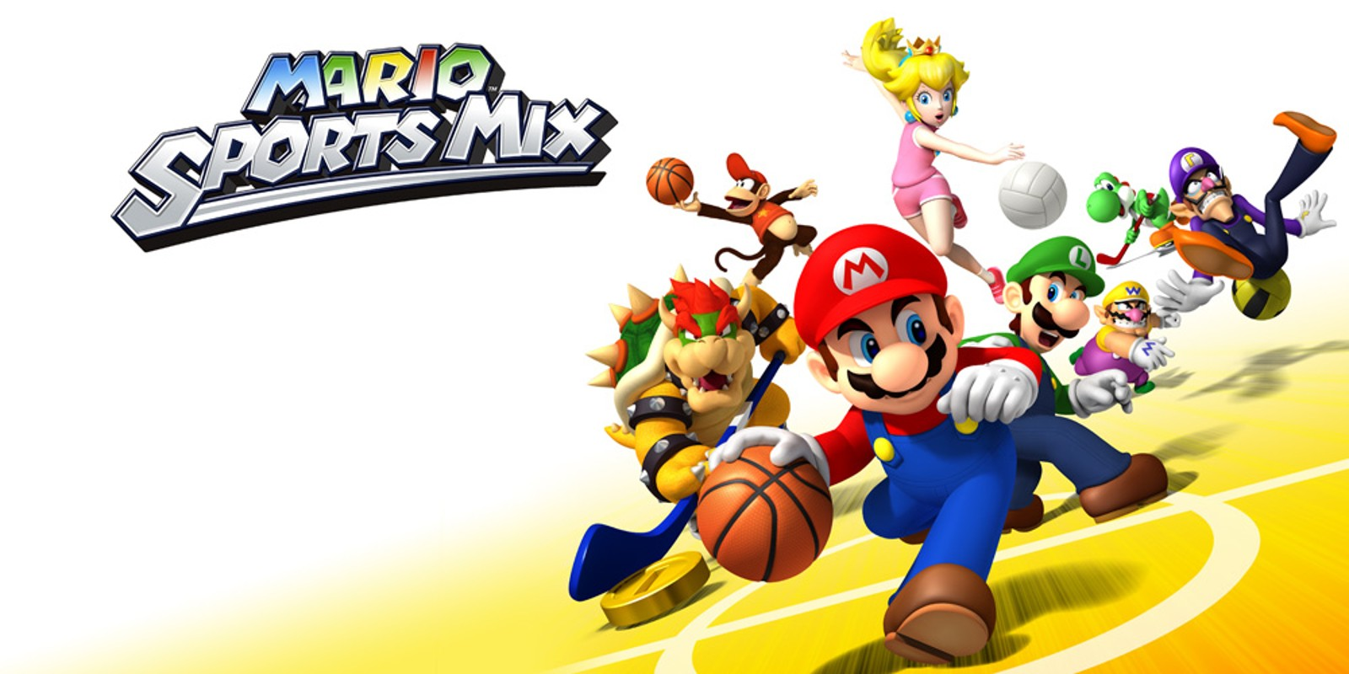
Industry Past
Sports Analytics Use Survey (2013)
Sample of 27 People (NFL, MLB, NBA, EPL)
How Many Different Sources?
1-2 (6.7%)
3-4 (33.3%)
5-6 (13.3%)
>6 (46.71%)

Slide 3
Industry Past
How Much Data is Centralized?
All (31.3%)
Most (37.4%)
Some (31.3%)
How Much Data is Dependent on One Person?
Some (50.0%)
Most (43.7%)
All Data Centralized (6.3%)

Slide 4
Industry Past
Is Data Checked for Errors?
Always (31.3%)
Usually (37.5%)
Sometimes (18.8%)
Occasionally (6.1%)
Rarely (6.3%)
How Many Database Programmers are Employed?
0 (37.5%)
1-2 (50.0%)
3-4 (0.0%)
>5 (12.5%)

Slide 5
Industry Past
How Many Statistical Analysts are Employed?
0 (20.0%)
1-2 (66.6%)
3-4 (0.0%)
>5 (13.3%)
Roadblock: Difficulty Identifying Strong Applicant
Difficulty in Both Hiring and Evaluating

Slide 6
Industry Past
Clear Process for Hiring/Evaluating Analysts
Strongly Agree (13.3%/14.3%)
Somewhat Agree (13.3%/14.3%)
Neutral (26.7%/28.6%)
Somewhat Disagree (13.4%/21.4%)
Strongly Disagree (33.3%/21.4%)
Analytic Resources in Line with Strategic Game Plan
Strongly Agree (26.7%)
Somewhat Agree (33.3%)
Neutral (33.3%)
Strongly Disagree (6.7%)

Slide 7
From Past to Present
Ben Alamar Updated Survey in 2nd Edition
163 People, 119 Orgs., 15 Sports
53% Use Statistics Regularly in Decision Making
58% Report Data is Mostly/Fully Centralized
32% Say Data is Regularly Presented Clearly and Consistently
83% Confirmed Analytics Group Will Grow in Next 5 Yrs.
Notable Differences Since 2013
Larger Datasets (Million Rows Per Game)
Due to Player Tracking (Approx. 25 Measurements Per Sec)
Measurements Across Whole Body
Speed at Which Questions Can be Answered is A Lot Faster

Slide 8
Industry Present
Value Placed on Sports Analytics
Business Research Company Analysis
Global Sports Industry $477.8B to $507.69B
Actual CAGR of 6.3% in 2024
Expected to Grow to $635.42B in 2029 (CAGR 5.8%)
Deloitte Article Sports Analytics Industry Trends 2024
Fan Data Aggregated and Managed
Increased Use in Generative AI

Slide 9
Industry Present
Value Placed on Sports Analytics
Grand View Research on Sports Analytics Market
Valued at $3.52B in 2023 and $4.47B in 2024
Expected CAGR Between 2024 and 2030 is 21.5%
Software Segment Dominates Services
On-Field Analytics Dominates Off-Field Analytics
$Projection in 2030=4.47∗(1+CAGR)^6$ =14.38
$14.38B
$3.52B
$4.47B
2023
2024
2030

Slide 10
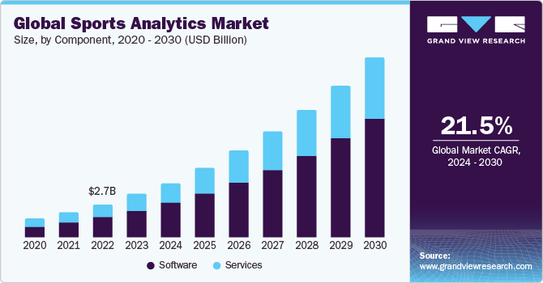
Industry Present
Value Placed on Sports Analytics
Grand View Research on Sports Analytics Market

Slide 11
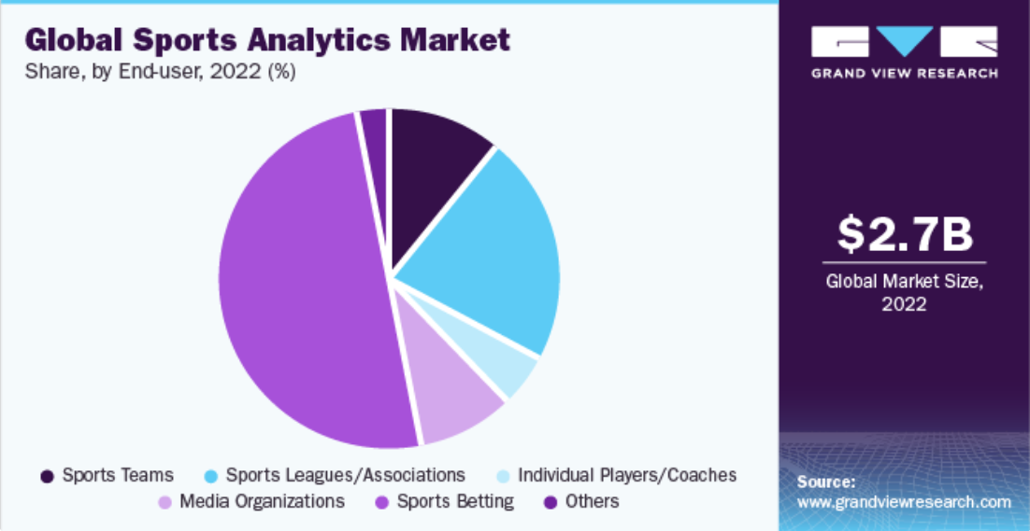
Industry Present
Value Placed on Sports Analytics
Grand View Research on Sports Analytics Market

Slide 12
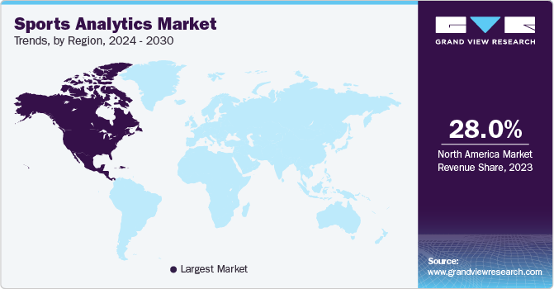
Industry Present
Value Placed on Sports Analytics
Grand View Research on Sports Analytics Market

Slide 13
Industry Present
Value Placed on Sports Analytics
Grand View Research on Sports Analytics Market
Agile Sports Analytics, LLC
Catapult Sports
ChrynoHego Corporation
Deltatre
Experfy Inc.
Genius Sports Group
IBM Corporation
Oracle Corporation
SAP SE
SAS Institute Inc.
Sportradar AG
Stats Perform

Slide 14
Industry Present
Modern Applications of Sports Analytics
Forbes Article from 2021 by Abhas Ricky
Helping the Team Win
Automated Video Analysis (Lincoln City, UK Football)
3D Depth Camera (NBA)
Wearable Technology (NBA, NHL)
Improving the Fan Experience
Analysis of Digital Engagement
Sentiment in Social Media
Analysis of Fan Behavior in Stadium (New England Patriots)
Wireless Internet and Phone Apps
Apps Supply Game Analytics, Parking Information, Promotions, and Traffic Information to the Fans (NFL)

Slide 15
Industry Present
Modern Applications of Sports Analytics
Benefiting Other Stakeholders
Tracking Fan Behavior Outside the Stadium
Telecommunication, Retailers, Payment Providers, Ticket Agencies, and Sponsorships
Adapt to Quick Changes in Consumer Behavior
Optimizing the Back-Office
HR Practices
Game Scheduling
Supply Chain Management and Logistics
Marketing and Promotions
Procurement of Goods and Services

Slide 16
Industry Present
Modern Applications of Sports Analytics
Advancing Sports Gambling
Supreme Court Ruling Previous Statute Violated 10th Amendment (Murphy v. National Collegiate Athletic Association)
States Free to Legislate Gambling
Improvement of Gambling Products
Data Aggregation and Visualization for Bettors
Develop Daily Fantasy Sports
Grandview Research of US Market
US Market Valued at $13.76B in 2023
Expected CAGR of 10.5% from 2024 to 2030
$$Projection in 2030=13.76∗{\left(1+0.105\right)}^{6}=\$25.05B$$

Slide 17
Your Industry Future
Prerequisites by Howard Hamilton
(Soccermetrics)
Technical Skills
Mathematics (Linear Algebra/Probability Essential)
Statistics (Frequentist and Bayesian Perspectives)
Machine Learning (Supervised and Unsupervised)
Programming (R/Python, Data Structures, OOP)
Databases
Visualization
Socials Skills, Ethics, and the Law
Knowledgeable About All Aspects of the Sport

Slide 18
Your Industry Future
Real Jobs (Builtin.com)
Trading Analyst, SeatGeek
Analyze Supply and Demand Data for Partners
Fluency in SQL and Python
Bacherlors Degree in Quantitative Field
Machine Learning Ops Engineer, GameChanger
Sports Tech Company Focused on Youth Sports
Design/Implement Machine Learning Model Pipelines
Background Building Machine Learning Infrastructure
Manage Computer Vision Models
Bachelors or Masters in CS, Engineering, etc.
Python with PyTorch and Tensorflow

Slide 19
Your Industry Future
Real Jobs (Builtin.com)
Senior Analyst, DraftKings
Former 538 Student Works There
3+ Years Experience
Bachelors Degree in Math, Stats, etc.
Proficiency in SQL, Snowflake, Tableau
Sports Statistician, Genius Sports
European Company but Remote
Probably Just Data Collection from Live Events
Paid Per Game

Slide 20
Your Industry Future
Real Jobs (Builtin.com)
Data Scientist, Twitch
Not Really Sports Analytics Specifically
Bachelors in Data Science, CS, Math, etc.
3 Years Experience in Data Science and ML
Expert SQL and Proficient in Python/R
Quantitative Analyst, Philadelphia Eagles
Work with Analytics Team in Football Operations
Strong Analytica Skills with Experience in Stats and ML
Proficient in R, Python, SQL
No Degree Requirement Mentioned

Slide 21
Your Industry Future
Real Jobs (Builtin.com)
AI Scientist, Trek Bicycle
Make Bicycles
Lead AI Projects Focused on Generative AI (GPT, Gemini, etc.)
Develop and Deploy AI Models
Skilled in Python, SQL, RAG, PyTorch, TensorFlow, etc.
Large Language/Small Language Model Background
Advanced Statistical and Mathematical Knowledge
Masters or PhD with 5-10 Years Experience
Principal Data & Visualization Analyst, Callaway Golf
Bachelors Degree in “STEM” Program
Skilled in SQL, Snowflake, Python, PowerBI, etc.

Slide 22
Your Industry Future
Conferences
MIT Sloan (March)
International Sports Analytics Conference (July)
UConn Sports Analytics Symposium (April)
OSU Sports Analytics Conference (April)
Carnegie Mellon Sports Analytics Conference (?)
New England Symposium on Stat. in Sports (2025)
Great Lakes Data and Analytics (April)
International Conference on Sports Analytics and Data Visualization (August)
More International Conferences (See Link on Website)

Slide 23
Final Inspiration
Defense wins championships.
Offense wins contracts.
Be offensive.
- Mahatma Mario

